Slide 1
Employee Data Analysis using Excel
STUDENT NAME:SHANMUGAPRIYA.S
REGISTER NO: 312206101/unm295SHANMUGAPRIYA S DEPARTMENT: B.COM Accounting & Finance
COLLEGE: Apollo Arts and Science College

Slide 2
PROJECT TITLE
Employee Performance Analysis using Excel

Slide 3


AGENDA
Problem Statement
Project Overview
End Users
Our Solution and Proposition
Dataset Description
Modelling Approach
Results and Discussion
Conclusion
3/21/2024 Annual Review

Slide 4

PROBLEM STATEMENT
Organizations frequently struggle with efficiently analyzing employee performance due to fragmented data and a lack of cohesive tools.
By leveraging Excel for Employee Performance Analysis, we intend to develop a straightforward yet effective solution that facilitates accurate measurement, visualization, and insights into employee performance, supporting improved decision-making and resource management.

Slide 5

PROJECT OVERVIEW
. The project focuses on creating an Excel-based tool for Employee Performance Analysis.
This tool will simplify data management, facilitate performance measurement, and offer visual insights, empowering organizations to make informed decisions that enhance workforce productivity and development.

Slide 6
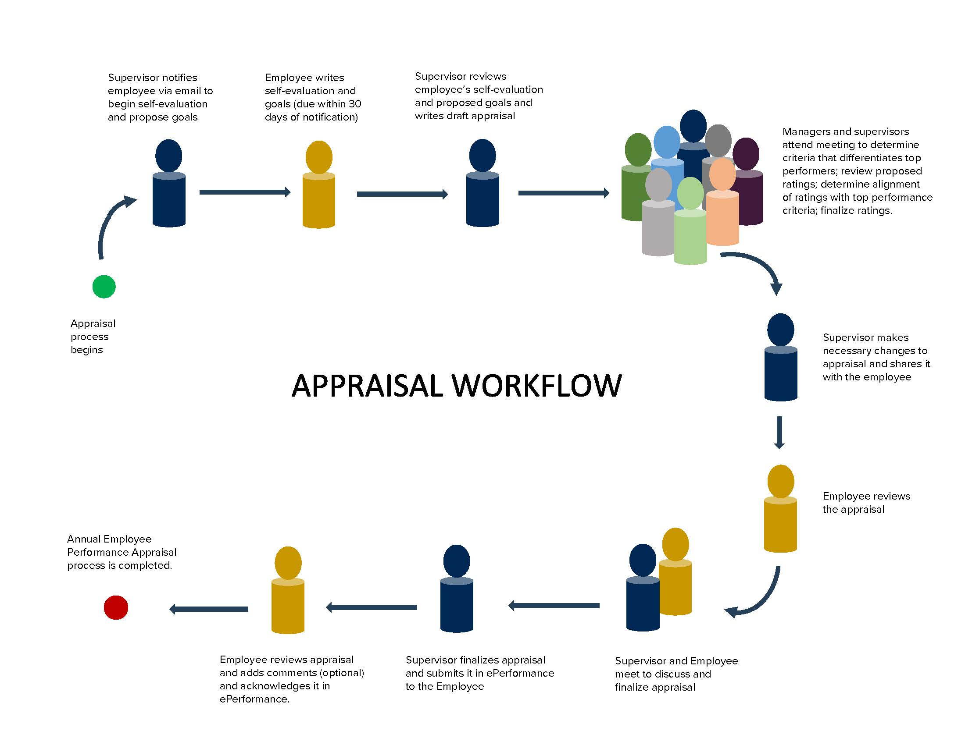

WHO ARE THE END USERS?

Slide 7

OUR SOLUTION AND ITS VALUE PROPOSITION
Highlighting - Features
Conditional Formatting – Missing
Filter – Remove
Formula - Performance
Pivot Table – Summary
Graph – Data visualization

Slide 8
Dataset Description
Employee Dataset – Edunet Foundations
26 – Features
9 – Features
Employee ID – Numerical data
Name – Text format
Employee Type – Text format (Full time/contract/Part time)
Performance level – Text format (Very High/ High /Medium/ Low)
Gender – Male/Female
Employee Rating – Numerical data (1 to 5)
Performance Score – Text (Exceeds/Fully meet/Need Improvement)
Employee Classification Type – Text Format(Full time, Part time , Temporary)
Business Unit - Text

Slide 9

THE "WOW" IN OUR SOLUTION
Formula =IFS(z8>=5,”Very High”,z8>=4,”High”,Z8>=3,”Medium”,True,”Low”)
3/21/2024 Annual Review
9

Slide 10
MODELLING
Data Collection:
Employee data were collected from Edunet Foundations.
Feature Selection:
The employee dataset originally had 26 features.
We selected 9 important features, including Login ID, First Name, Business Unit, Employee Status, Employee Type, Performance Level, Employee Rating, Gender, and Performance Score.
10

Slide 11
MODELLING
Data Cleaning:
Highlighting Blank Columns:
Use conditional formatting to highlight blank cells.
Navigate to Conditional Formatting > Highlight Cell Rules > More Rules (a new formatting dialog box will open).
Select Format only cells with and choose the Blanks option.
Click on Format > Fill > Select Red color and then click OK.
11

Slide 12
MODELLING
Data Cleaning:
2.Filtering and Removing Blank Columns:
To filter and remove blank columns, select the "Exit Date" column.
Go to Sort & Filter > Filter.
The filter icon will appear on the Exit Date column. Click on it to filter out blank cells.
The blank rows will then be removed from the dataset.
12

Slide 13
MODELLING
Performance Level:
Identify the performance level using the following formula: =IFS(Z8>=5, "Very High", Z8>=4, "High", Z8>=3, "Medium", TRUE, "Low")
Visualization:
Create a Pivot Table:
Go to Insert > Pivot Table.
Select the table and range, and choose to create the Pivot Table in a new worksheet.
The Pivot Table will be created.
13

Slide 14
MODELLING
Set up the Pivot Table:
Select Business Unit for Rows.
Select Performance Level for Columns.
Use Gender as a filter.
Add First Name as the value.
Create a Chart:
Go to Insert > Recommended Charts.
The chart will be created automatically.
Name the chart as "Employee Performance Analysis".
14

Slide 15
RESULTS
15

Slide 16
conclusion
The chart reveals that most employees across the business units fall within the "Medium" performance level, indicating an overall average performance. However, noticeable variations exist, with some units having higher numbers of "Low" and "Very High" performers. This suggests that targeted interventions may be necessary to address these disparities and enhance performance at all levels.

